Slide 1
Human Gait Recognition And Classification Using Image Processing
BATCH MEMBERS
Under the Guidance of,

Slide 2
CONTENTS
AIM & OBJECTIVE
LITERATURE SURVEY
EXISTING SYSTEM
PROPOSED SYSTEM
Human Features
1: Initialization of body shape model
2: Tracking
3: Recognition Features
4: Recognition Features
CONCLUSION
REFERENCES

Slide 3
AIM&OBJECTIVE
Biometric identification like fingerprints, retina, palm and voice recognition needs subject's permission and physical attention.
Human Gait recognition works on the gait of walking subjects to identify people without them knowing or without their permission.
The purpose of this Project is to detect humans based their Waling styles.
We first extract the gait features from image sequences using the Feature Module. Features are then trained based on the frequencies of these feature trajectories, from which recognition is performed.

Slide 4
OBJECTIVE
Gait recognition is a promising topic in the biometric technology.
The main aim of the technique identifies individuals based on their walk style.

Slide 5
LITERATURE SURVEY
TITLE | AUTHOR | MONTH/ YEAR |  | EXPLANATION
Analyzing and Recognizing Walking Figures in XYT | S. A. Niyogi, E. H. Adelson | December 2017 |  | The study in extracts 2D XT sheets that encode the person’s inner and outer bounding contours. The approach in is first restricted to gait front parallel to the camera Pros. Better Features Extraction Applied Cons. Less Accuracy
Gait Sequence Analysis using Frieze Patterns | Yanxi Liu, R. T. Collins, T. Tsin | 2018 |  | a spatio-temporal gait representation is generated by projecting the body silhouette along its columns and rows, then stacking these 1D projections over time to form a 2D pattern Pros: Better Classification Results Cons: Only Considered 2D Patterns
Silhouette-Based Human Identification from Body Shape and Gait | R. Collins, R. Gross, and J. Shi | 2017 |  | Gait period analysis serves to determine the frequency and phase of each observed sequence so as to align sequences before matching. Pros: Considered Body shape features also. Cons: Incomplete work
Silhouette Analysis-Based Gait Recognition for Human Identification | L. Wang, T. Tan, H. Ning, W. Hu | March 2017 |  | the aspect ratio of the bounding box of a moving silhouette, as a function of time, is also used to determine the period of the gait. Pros. Applicable for all video format Cons. Less Accuracy
Detecting Activities | R. Polana, R. Nelson | 2018 |  | they used similar techniques as in to judge the degree of periodicity. They compute a reference curve (which is essentially a trajectory) by tracking the centroid of a moving region in several frames. Pros: Movement Modules implemented. Cons: Incomplete work

Slide 6
EXISTING SYSTEM
In the existing system a Multi-view Gait Generative Adversarial Network (MvGGAN) to generate gait samples to extend gait datasets, which provides adequate gait samples for deep learning-based cross-view gait recognition methods.

Slide 7
DISADVANTAGES
Less Accuracy
Static Recognition
Invalid Features generated.

Slide 8
PROPOSED SYSTEM
Gait recognition is the process where the features of human motion are automatically obtained/extracted and later these features enable us to authenticate the identity of the person in motion.
As like other pattern recognition techniques, gait recognition technique also involves 2 stages:
Information is derived from human locomotion in the first stage i.e. feature extraction stage.
In the next stage, i.e. the recognition stage, a standard similarity computation technique (Incremental Component Analysis) is used to obtain results for being a match or a mismatch.

Slide 9
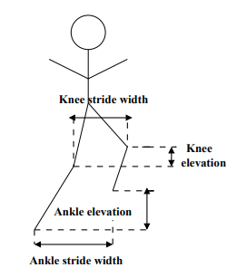
Human Features

Slide 10
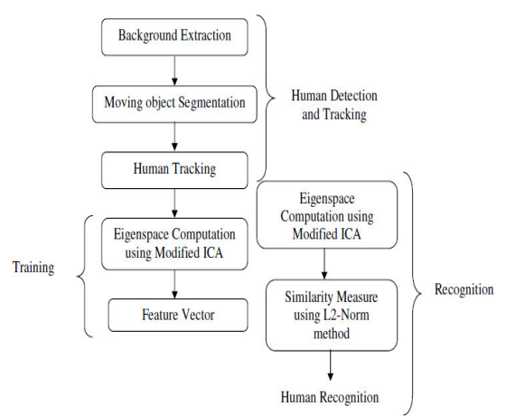
FLOW DIAGRAM

Slide 11
ADVANTAGES
High Accuracy system
Complex to system to Hack
High security recognition
3D Supports Available

Slide 12
1: Initialization of body shape model
The orientation and the actual length of each body part in the image are defined in the initialization step.
We choose to fit the Frame image when the two legs are furthest apart from each other (double stance phase).

Slide 13
2: Tracking
Since we have extracted the shape model and the initial configuration, the next step is to extract gait signatures over time based on this shape model.
Current 2D-based tracking methods use either image edges or dense optical flow for detection and tracking

Slide 14
3: Recognition
The sagittal elevation angles extracted from the above tracking procedure capture the temporal dynamics of the gait of the subject,
whereas the trajectories of the corresponding joint position reveal the spatial-temporal history.

Slide 15
4: Recognition Features
Based on the tracking results obtained with the biped model, the differences across people are largely temporal.
It is, therefore, necessary to choose a feature representation that makes the temporal characteristics of the data signal explicit.

Slide 16
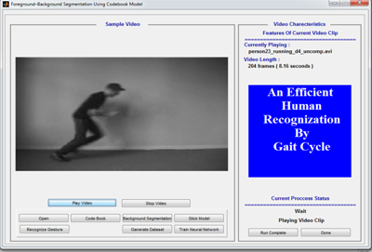
RESULTS

Slide 17
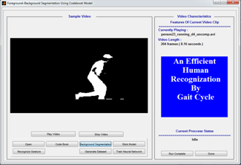
RESULTS

Slide 18
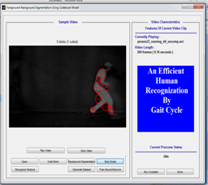
RESULTS

Slide 19
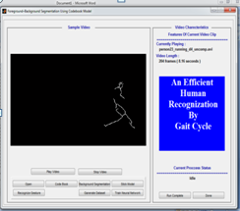
RESULTS

Slide 20
CONCLUSION
In this project, we have shown a novel 2-step, model-based approach for gait recognition using human body movements exclusively.
As the concealable shape information is avoided, our method is more robust than the shape-based ones.

Slide 21
REFERENCES
[1] S. Ayer and H. S. Sawhney. Layered representation of motion video using robust maximum-likelihood estimation of mixture models and MDL encoding. In IEEE International Conference on Computer Vision, pages 777–784, 1995.
[2] A. Borghese, L. Bianchi, and F. Lacquaniti. Kinematic determinants of human locomotion. J. Physiology, 494(3):863– 879, 1996.
[3] R. T. Collins, R. Gross, and J. Shi. Silhouette-based human identification from body shape and gait. In International Conference on Automatic Face and Gesture Recognition, 2002.
[4] D. Cunado, M.S. Nixon, and J.N. Carter. Using gait as a biometric, via phase-weighted magnitude spectra. In 1st Int. Conf. audio and video based biometric person authentification, 1997.

Slide 22
REFERENCES
[5] A. Elgammal, D. Harwood, and L. Davis. Non-parametric model for background subtraction. In 6th European Conference on Computer Vision, 2000.
[6] J. P. Foster, M. S. Nixon, and A. Prudel-Bennett. Automatic gait recognition using area-based metrics. Pattern Recognition Letters, 24(14):2489–2497, 2001.
[7] R. Gross and J. Shi. The CMU Motion of Body (MoBo) database. Technical Report CMU-RI-TR-01-18, Robotics Institute, Carnegie Mellon University, Pittsburgh, PA, June 2001.
[8] J.B. Hayfron-Acquah, M.S. Nixon, and J.N. Carter. Automatic gait recognition by symmetry analysis. Pattern Recognition Letters, 24(13):2175–2183, September 2003.

Slide 23
THANK YOU

